Slide 1

Classifying Wines Using Machine Learning
David Ndiritu mwaniki
8th JULY 2025
From Vineyard to Vector
WWW.REALLYGREATSITE.COM
Stockholm Vineyard

Slide 2

Introduction
Background of the study
Wines from the same region can exhibit subtle differences in chemical composition due to variations in cultivation methods and environmental conditions. These differences impact taste, aroma, and quality—making accurate classification essential for quality control.
Relevance of the study
The winery aims to streamline its quality assurance processes by using machine learning to classify wines automatically. Understanding which chemical attributes contribute most to classification can also reduce testing costs by eliminating less relevant tests.
Objective of the study
To apply machine learning techniques to classify wine cultivars using chemical test data. The study also aims to identify the most significant features influencing classification and evaluate whether fewer tests can still ensure accurate results

Slide 3
Problem Statement
BUSINESS PROBLEM
The winery seeks to improve quality assurance by automating the classification of wines based on their chemical properties. Currently, wines are tested across 13 chemical attributes, but the winery wants to identify if all features are necessary or if some can be eliminated to reduce testing costs. Additionally, the manual process is time-consuming and subjective; thus, there’s a need for an accurate, scalable, and objective classification system.
The task is to classify wines into one of three cultivars (Classes 0, 1, or 2) using their chemical composition.
The study also aims to:
1
Predict the correct wine class based on chemical properties.
2
Classify wines automatically using machine learning models
3
Optimize feature selection to reduce the number of chemical tests required, thereby minimizing operational costs while maintaining classification accuracy.
VISUALIZE FINDINGS
5

Slide 4
Data Description
Feature Name | Description
fixed_acidity | Tartaric acid level
volatile_acidity | Acetic acid content
citric_acid | Citric acid level
residual_sugar | Sugar after fermentation
chlorides | Salt content
free_sulfur_dioxide | Antioxidant level
total_sulfur_dioxide | Preservative content
density | Relative density of the wine
pH | Acidity level
sulphates | Sulfate level (stabilizer)
alcohol | Alcohol percentage
quality | Target variable (quality score)
Sources of data
The dataset was obtained from the sklearn.datasets module using the built-in load_wine() function. It contains the results of chemical analysis of wines from the same region in Italy but derived from three different cultivars.

Slide 5
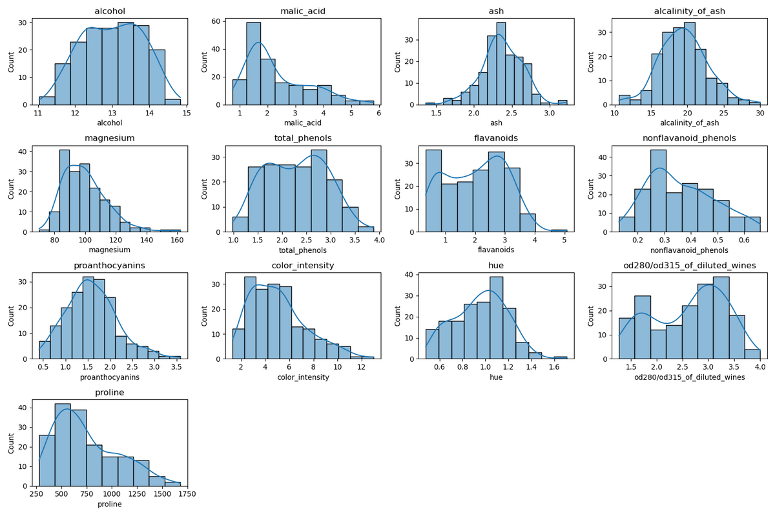
Normal Distribution of Features
Feature | Distribution Shape | Insight
alcohol | Symmetrical, slightly skewed | Normal-like distribution
malic_acid | Right-skewed | Most wines have low malic acid
ash | Nearly normal | Centered around 2.5
alcalinity_of_ash | Symmetric | Slight peak near 20
magnesium | Right-skewed | Most values are between 70–100
total_phenols | Fairly uniform | Spread evenly from 1–3
flavonoids | Right-skewed | Many wines with low values
nonflavanoid_phenols | Right-skewed | Similar pattern to flavonoids
proanthocyanins | Normal-like | Balanced spread
color_intensity | Right-skewed | Few very intense-colored wines
hue | Bell-shaped | Typical range 0.8–1.2
od280/od315_of_diluted_wines | Bimodal | Two common groups of wines
proline | Strongly right-skewed | Few wines have very high proline
Summary of Findings
Most features are right-skewed – such as malic_acid, magnesium, proline, and color_intensity. This suggests a concentration of lower values with fewer high-value outliers.
Some features are roughly normally distributed, like ash, alcohol, and hue, making them well-suited for models assuming normality.
A few features show bimodal patterns, especially flavanoids and od280/od315_of_diluted_wines. This could indicate strong class-separating potential.
Proline has a wide range with a strong right skew, indicating it could be a powerful differentiator among wine types.
Feature transformation (e.g., log scaling) might be helpful for skewed features to improve model performance.

Slide 6
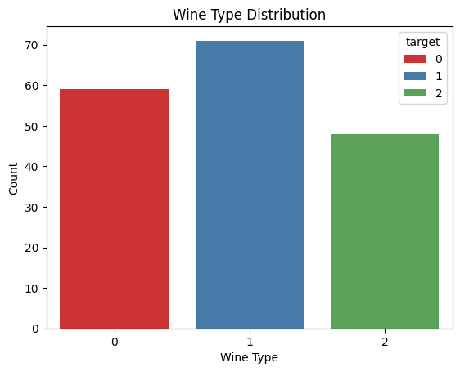
Wine Type
Distribution Analysis
Wine Type Distribution – Analysis
The dataset contains three wine types, labeled as 0, 1, and 2.
Wine Type 1 is the most represented, with approximately 71 entries.
Wine Type 0 follows with about 59 entries.
Wine Type 2 has the lowest representation, with around 48 entries.
Observations:
The data is relatively balanced, though Wine Type 1 has a noticeable lead.
The class imbalance is not extreme, but it's something to be aware of when training classification models, as it could slightly influence performance metrics.

Slide 7
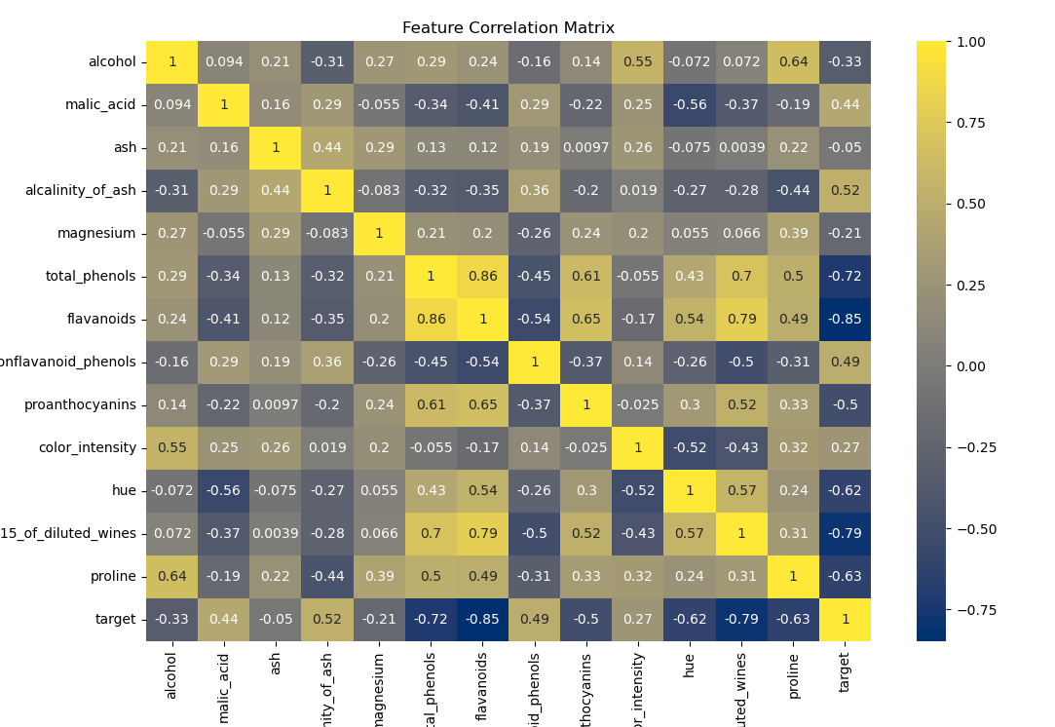
Key Insights from Feature Correlations
The heatmap reveals that flavanoids, total phenols, and OD280/OD315 are highly correlated, suggesting they may represent similar underlying wine characteristics—likely related to antioxidant or polyphenol content. This can help in reducing dimensionality or selecting the most informative feature during model building.
Additionally, the strong negative correlation between malic acid and hue highlights a possible link between wine acidity and color tint, which could reflect quality or type.
Understanding these relationships aids in:
Improving model accuracy by avoiding redundant features,
Interpreting chemical composition linked to wine quality,
And enhancing feature selection for classification or prediction tasks.

Slide 8
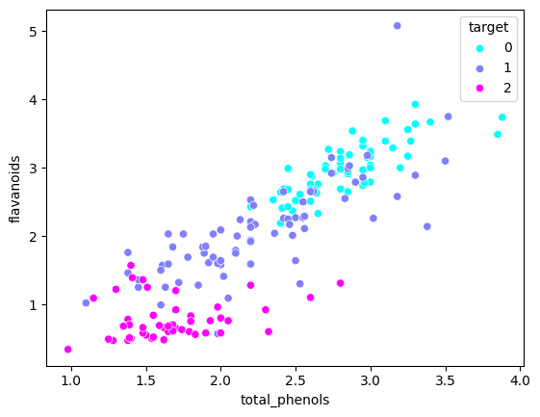
Flavanoids vs. Total Phenols Relationship
From the previous correlation heatmap, we observed a strong positive correlation (0.86) between flavanoids and total_phenols. This scatter plot confirms that relationship visually — as the total_phenols content increases, the flavanoids also tend to increase.
Key Insight:
The points form a clear upward trend, indicating a strong linear relationship.
This suggests that wines with higher total phenolic content generally contain more flavanoids, reinforcing the idea that flavanoids are a major component of total phenols.

Slide 9
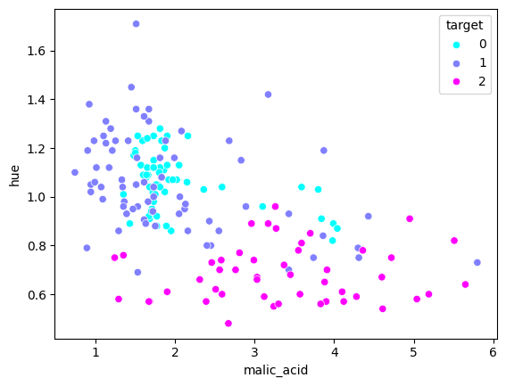
Malic Acid vs. Hue Relationship
From the previous correlation heatmap, we identified that malic_acid and hue had the strongest negative correlation (–0.56) among all feature pairs.
While this scatter plot does not show a clear linear downward trend, we can still observe a slight negative pattern, suggesting that as malic acid increases, the hue tends to decrease.
Key Insight:
The slight downward spread reflects that features like acidity (malic acid) may influence visual properties of wine such as color tint (hue).
This relationship, though not perfectly linear, supports the idea that wine composition affects appearance, and can be considered in modeling or quality analysis.
It highlights subtle but meaningful chemical relationships useful for classification or prediction tasks.

Slide 10
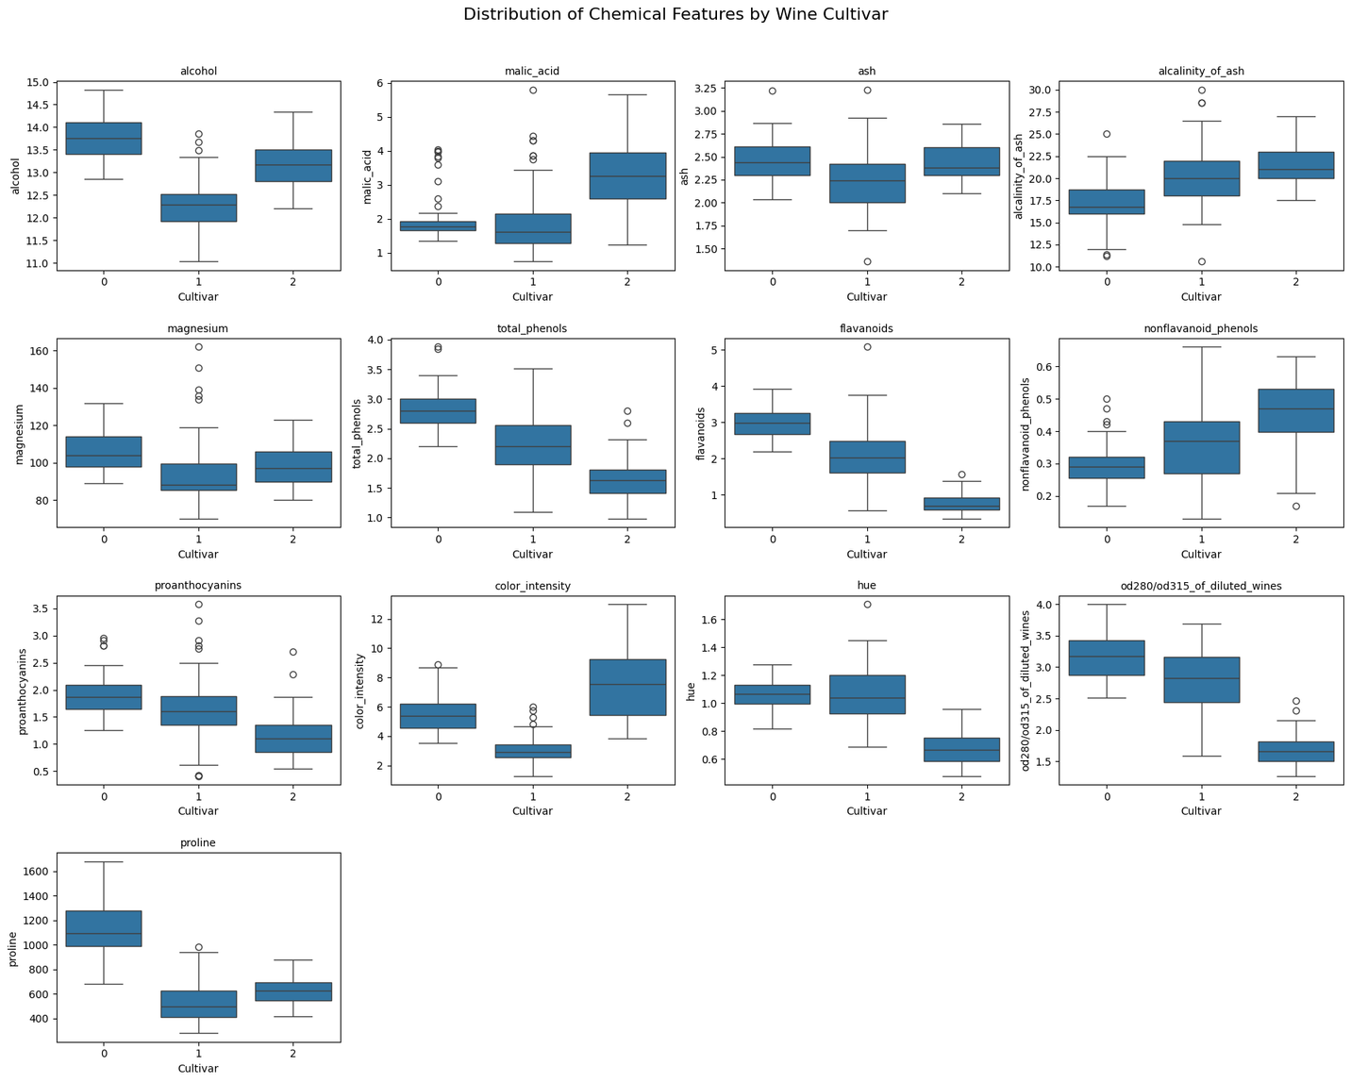
Malic Acid vs. Hue Relationship
Several ingredients clearly help differentiate the three wine cultivars:
Proline is the strongest indicator for Cultivar 0, with much higher values than the others.
Color Intensity stands out for Cultivar 2, showing the highest median and range.
Alcohol helps distinguish Cultivar 1, which has the lowest average.
OD280/OD315 and Hue are useful in identifying Cultivar 2, both showing distinct value patterns.
Flavanoids and Total Phenols effectively separate Cultivar 0 from Cultivar 2.
Less useful features include Ash, Magnesium, and Alcalinity of Ash, which show high overlap.

Slide 11
Exploratory Data Analysis
Key findings: trends, outliers, correlation
Trends :
Wine Class 0 has the most samples, while Class 2 has the fewest.
Class 0 wines tend to have higher values in features like Proline, Flavanoids, and Total Phenols.
Class 1 shows the lowest Alcohol content, clearly separating it from the other two.
Class 2 stands out with higher Color Intensity and a wider range of Malic Acid values.
Outliers :
No significant outliers were detected; most values across features appeared to be within a close range.
The dataset is fairly clean, with no extreme anomalies affecting the analysis or model performance.
Correlation :
Most features showed low to moderate correlation, indicating they contribute independent information.
Flavanoids and Total Phenols showed the strongest positive correlation (+0.86), suggesting wines with more phenols tend to have higher flavonoids.
This strong correlation may indicate a shared chemical characteristic common in certain wine classes, especially Class 0.

Slide 12
Exploratory Data Analysis
Data preprocessing steps: handling missing data, encoding, scaling
Missing Data:
The dataset contained no missing values, so no imputation or removal of data was necessary.
Encoding:
Encoding was not required, as all features were already in numerical format suitable for machine learning models.
Feature Scaling:
The data was scaled using StandardScaler, which standardises features by removing the mean and scaling to unit variance.
This step was essential to ensure that features like proline (large values) and flavanoids (smaller values) were on a comparable scale, especially important for distance-based models like KNN and SVM.

Slide 13
Methodology
Data Exploration & Preprocessing
Dataset Used: sklearn.datasets.load_wine
178 samples, 13 chemical features, and 3 target wine cultivars (0, 1, 2)
Missing Values: None detected
Encoding: Not required (all features were numerical)
Scaling: Applied StandardScaler to standardize feature values (mean = 0, variance = 1)
Feature Engineering & Selection
Recursive Feature Elimination (RFE) was used with Logistic Regression and Random Forest to identify the most informative chemical features, supporting cost-saving and model optimization.
Key features selected: Flavanoids, Proline, OD280/OD315 ratio, Color Intensity, Alcohol
Train-Test Split & Cross-Validation
Data split into 80% training and 20% testing using stratified sampling to maintain class distribution.
Applied K-Fold Cross-Validation (k=5) (for KNN)during training to ensure model generalizability and avoid overfitting.

Slide 14
Methodology
Model Training
Trained and evaluated the following five classification algorithms:
Model
K-Nearest Neighbors (KNN) - Simple, instance-based learner, good for comparison
Logistic Regression - Linear model, interpretable and fast
Decision Tree - Rule-based, good for feature importance
Random Forest - Ensemble of trees, robust to overfitting
Support Vector Machine (SVM) - Tried with linear & RBF kernels, good for margin-based classification
Dimensionality Reduction
Applied Principal Component Analysis (PCA) to project the dataset into 2D for visualizing natural separation between the three wine cultivars.
Used top 2 principal components capturing >80% of total variance.

Slide 15
Modelling & Evaluation
Model | Accuracy | Macro Avg F1-Score
K-Nearest Neighbors (KNN) | 0.98 | 0.98
Logistic Regression (w/o RFE) | 0.98 | 0.98
Support Vector Machine (SVM) | 0.98 | 0.98
Logistic Regression (with RFE) | 0.96 | 0.96
PCA + Logistic Regression | 0.96 | 0.97
Decision Tree | 0.96 | 0.96
Random Forest | 0.93 | 0.93

Slide 16
Modelling & Evaluation
Seven classification models were trained to predict wine cultivars based on chemical properties.
The top-performing models—KNN, SVM, and Logistic Regression (full features)—each achieved 98% accuracy, demonstrating excellent precision and recall across all classes.
Models using Recursive Feature Elimination (RFE) and PCA maintained high performance (96% accuracy), supporting the objective of reducing lab testing costs while preserving accuracy.
Although Decision Tree performed reasonably well, Random Forest showed lower accuracy (93%), likely due to overfitting or class imbalance.
Overall, the results confirm that wine cultivars are highly distinguishable through machine learning, with SVM and Logistic Regression emerging as ideal choices for automation due to their balance of performance, interpretability, and efficiency.
The modeling results show that machine learning can be effectively used for wine classification with fewer chemical tests, offering clear cost and time savings. Even with reduced features, model performance remained high

Slide 17
Results & Insights
Key Findings from the Model
All models achieved high accuracy (above 92%), with KNN performing best at 98.1%, showing that the dataset is highly classifiable.
Top contributing features identified were Proline, Flavanoids, Color Intensity, and OD280/OD315, which significantly influenced classification.
Patterns or Relationships Discovered
Wines from Cultivar 0 generally have higher Proline and Flavanoids, making them easier to distinguish.
Cultivar 2 stands out with higher Color Intensity and lower OD280/OD315, helping separate it from the others.
Strong positive correlation found between Total Phenols and Flavanoids (r = 0.86), indicating a shared chemical trait.
Business or Domain Interpretation
Chemical composition can be used reliably to automate wine classification, supporting quality control and vineyard management.

Slide 18
Recommendations
📌 What Should Stakeholders Do?
Adopt automated classification using SVM or Logistic Regression for consistent, high-accuracy predictions.
Reduce the number of chemical tests by focusing on the most predictive features (e.g., Flavanoids, Proline, OD280/OD315).
💡 Actionable Insights from Data
Implement a cost-efficient lab protocol using selected features without compromising classification performance.
Use PCA-based visual reports for internal communication and training, helping non-technical teams understand cultivar separation.
Continuously monitor model performance to ensure real-world accuracy remains high post-deployment.

Slide 19
Conclusions
🔁 Recap
This project aimed to automate wine cultivar classification using chemical analysis data. We explored the dataset, applied feature selection and dimensionality reduction, and trained multiple machine learning models to identify the most accurate and efficient approach
🎯 Key Takeaway
Accurate wine classification is achievable using fewer chemical tests, with models like SVM and Logistic Regression achieving up to 98% accuracy—supporting both automation and cost reduction.
📝 Final Remarks
The results confirm that machine learning can streamline wine quality control. By focusing on the most informative features and maintaining regular model updates, the institute can ensure efficient, scalable, and reliable wine classification.

Slide 20
Thankyou
David Ndiritu Mwaniki
Stockholm vineyard
8th July 2025
WWWSTOCKHOLMVINYARD.COM

